Slide 1
Fast Food Nutritional Analysis
By
MOHIT KUMAR

Slide 2
OVERVIEW
The project involves analyzing the nutritional content of various fast food items from popular chains, focusing on metrics such as:
calories
Fats
Cholesterol
sodium and more.

Slide 3
COMPANIES
McDonald’s: Offers a wide range of high-calorie menu items.
Burger King: Known for calorie-dense options, similar to McDonald’s.
Subway: Often provides lower-calorie, healthier alternatives.
Wendy’s: Features a variety of menu options, with moderate to high calories.
Chick-fil-A: Offers relatively healthier options, but some high-calorie items.
Taco Bell: Menu includes both low-calorie and higher-calorie items depending on the meal choice.

Slide 4
"How can we use the company distribution to add more variety to our menu?“
By looking at how items are spread across companies, we can find chances to add more variety by offering items from companies that have fewer options on the menu.

Slide 5
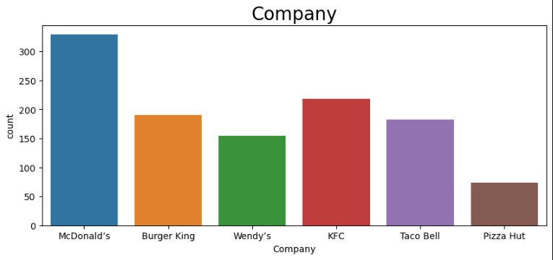
COMPANY AND DISTRIBUTION

Slide 6
"How can we leverage the popularity of the top 5 items to drive healthier menu choices?“
By analyzing the top 5 most popular items, we can explore healthier versions of these dishes or introduce similar items with better nutritional value, helping to maintain customer satisfaction while promoting healthier options.

Slide 7
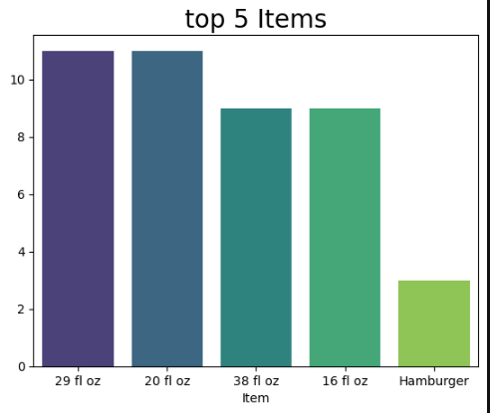
TOP 5 ITEMS

Slide 8
"How can we improve the highest-calorie item on our menu to make it healthier?“
By analyzing the highest-calorie item, we can explore ways to lower its calorie content, such as adjusting portion sizes or modifying ingredients, while keeping the dish appealing to customers. This will help improve the overall health profile of our menu.

Slide 9
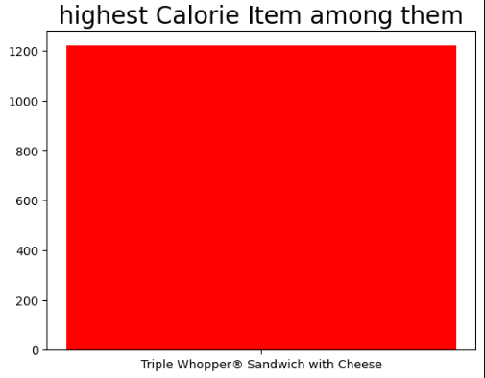
HIGHEST CALORIE ITEM

Slide 10
"How can we address the top 5 highest-calorie items to make our menu healthier?“
By focusing on the top 5 highest-calorie items, we can reformulate these dishes or offer smaller portions to reduce calorie content while still maintaining customer satisfaction.

Slide 11
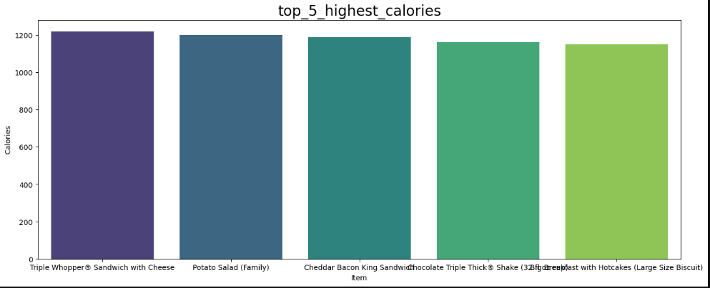
TOP 5 HIGHEST CALORIE

Slide 12
"How can we use the top 5 highest-sugar items to improve our menu's health offerings?“
By identifying the top 5 items with the highest sugar content, we can focus on modifying or offering healthier alternatives to these items, helping to reduce overall sugar consumption and offer more health-conscious menu options.

Slide 13
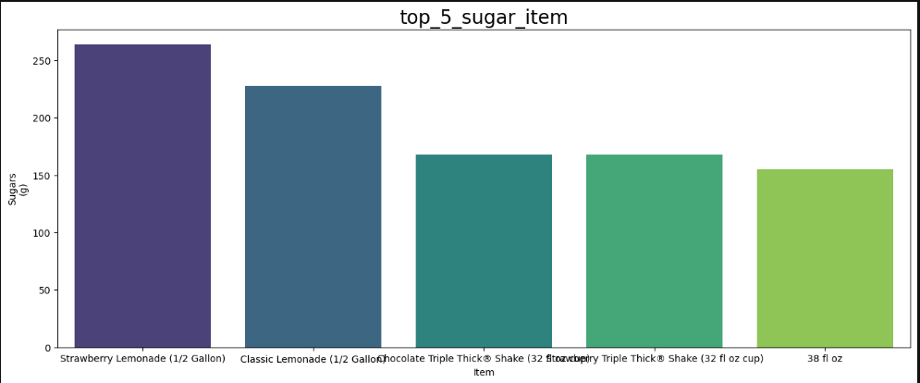
TOP 5 SUGAR ITEM

Slide 14
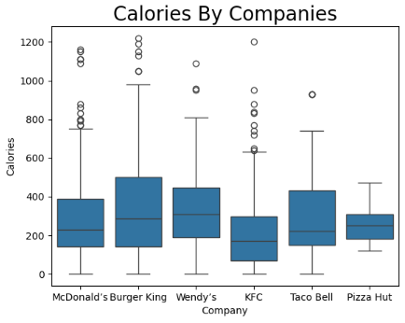
Which companies has the highest calories?

Slide 15
Conclusion:
The analysis reveals significant differences in calories across companies, with fat being a major contributor. Some menu items also stand out as high-calorie or high-sodium outliers. These insights can guide both businesses and consumers in making healthier choices.

Slide 16
Thank You

